Slide 1
Capstone Project -1 Team Supernova : Hotel Booking Analysis
Team Members
Affan Ahmad Abdul Wahid
Rithun Rajendran M.K
Prajwal Bharadwaj
Shreyash Kumar
Md Ashique Ali

Slide 2

Hotel Booking Analysis
Presented By : Team Supernova

Slide 3
Point For Discussion
Summary of Data
Data wrangling
Data Analysis
Data Visualization
Conclusion
Challenges Faced
We will discuss each topic in detail

Slide 4
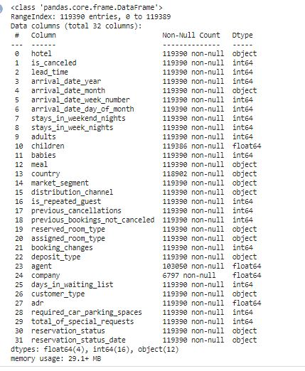
Summary of Data
This dataset has a shape of 119390 and 32 which mean that it contains 119390 rows and 32 columns.
This data contains hotel,is_canceled,lead_time,arrival_date_year,arrival_date_month,stays_in_weekend_nights,stays_in_week_nights,adults,children,babies,meal,country,market_segment,etc total 32 columns

Slide 5
Data Wrangling
Data Cleaning:
This data file consist of null values ‘NAN”
Replaced those null values with zero
Data Preparation:
Data file consist of different types of data types
Data type: int,float,object
In this process we romoved errors in data file

Slide 6
Data Analysis
What will the overview of arrival period?
From which country most guests come?
Which room type is most booked?
Find the Distribution channel with high cancelation_percentage(%)?
Which meal type is most preffered meal of customers?
Obtain the number of Adults reserving , and the number of Families with children reserving

Slide 7
What is percentage of booking in each hotel?
Which agent makes most no. of booking ?
What is the percentage of the repeated customers?
What is Preferred stay length in each hotel ?
Which hotel has high chance that its customer will return for another stay?

Slide 8
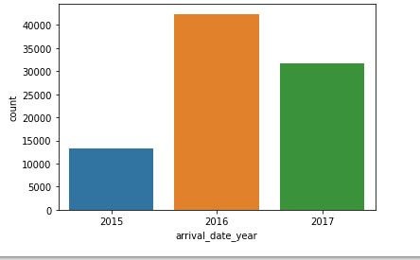
Data Visualization
Over View of arrival period:
The graph shows the arrival of customer in a year.
The arrival of people in 2016 is double compared to 2015 but has graudally decreased in 2017.

Slide 9
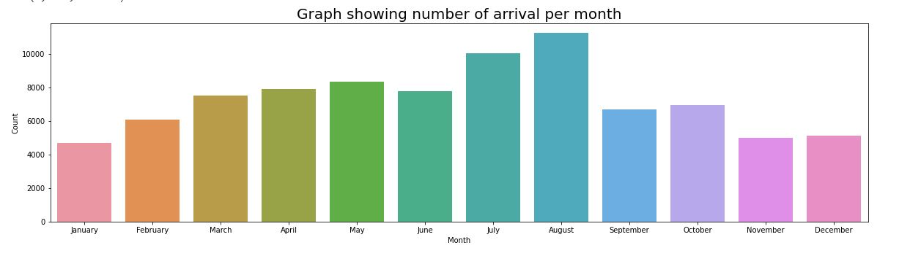
Arrival of customer per Month:
Here we can see that the August month has the maximum no. peoples arrived and Jauary has the least people arrived in hotel.

Slide 10
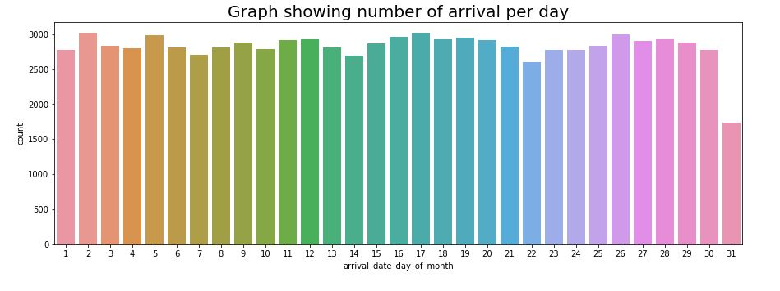
Arrival of Customer per day :
As shown in the graph the second day is having maximum arrival and 31st as the least arrival in hotel.

Slide 11
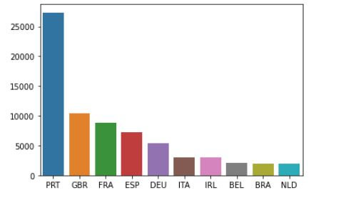
Country’s most guests come:
Graph show the from which county most guests come. Portugal, united kingdom, France, Spain and Germany are the top countries from most guests come. More than 80% come form Portugal,UK, France, Spain and Germany.

Slide 12
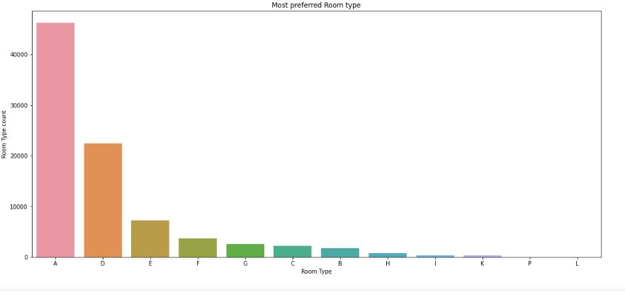
Most Booked room type:
A type room is most booked room, as shown in the graph

Slide 13
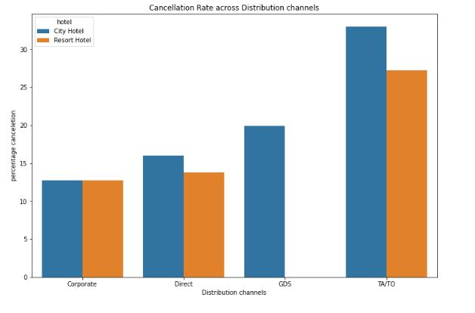
Distribution Channel with high cencelation_percentage:
TA/TO has the highest cancelation percentage. In city hotel it is 35% and in resort hotel it is 28%.

Slide 14
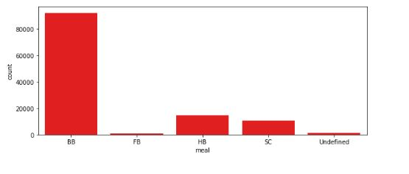
Most Preffered meal of customers:
As shown in the graph, we can take a result that most common type of meal is BB(Bread and breakfast).

Slide 15
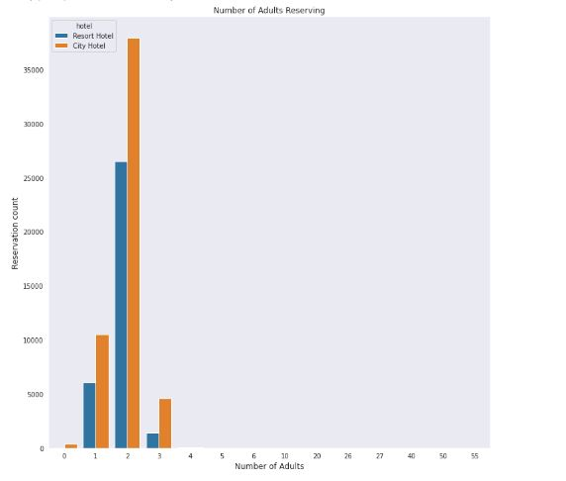
Adults Reservation in Hotel:

Slide 16
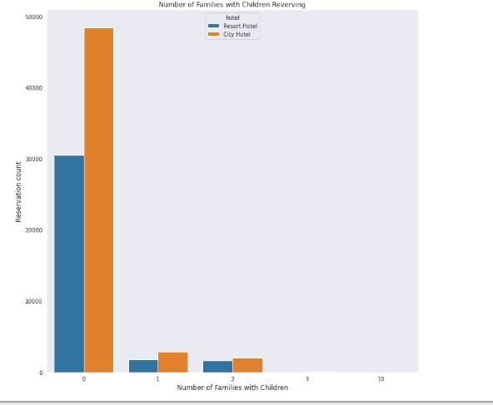
Families with Children Reservation:
From above two graph ,in the first graph the adults with pair has most reservations and in the second graph adults with zero children is having most booking, so we conclude that the adults without children has more bookings

Slide 17
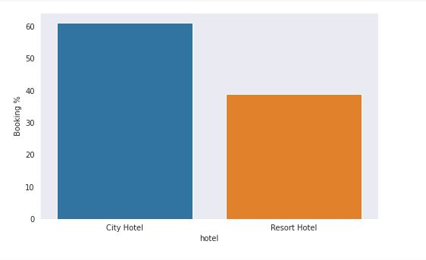
Percentage of Booking in each hotel:
The percentage of booking of city hotel is 60% and the percentage in resort hotel comes down to 36%.

Slide 18
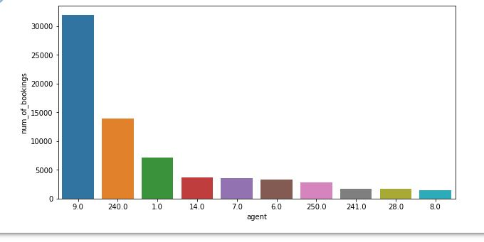
Agent with most number of bookings:
A booking agent ‘9.0’ has the most number of booking ie 30000 bookings and agent ‘8.0’ with least number .

Slide 19
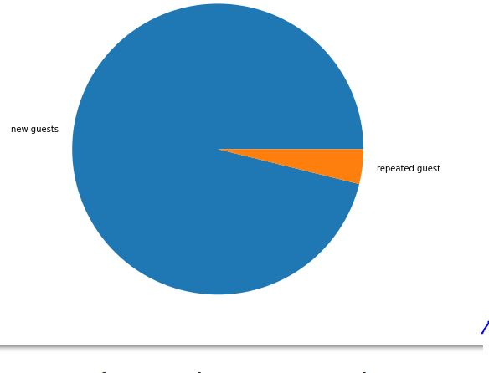
Percentage of the repeated customers:
In the above graph 3.86% is the booking percentage of repeated guests and the percentage of new guests is 96.14%

Slide 20
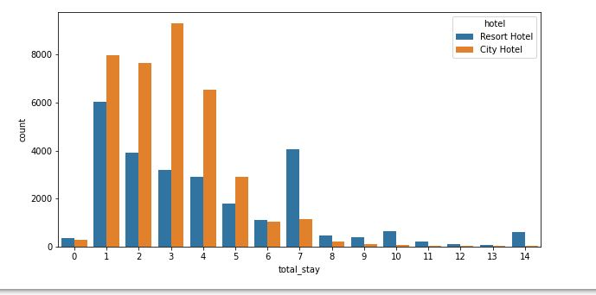
Preferred stay length in each hotel:
Most common stay length is less than 4 days and generally people prefer city hotel for short stay, but long stays resort hotels is preffered.

Slide 21
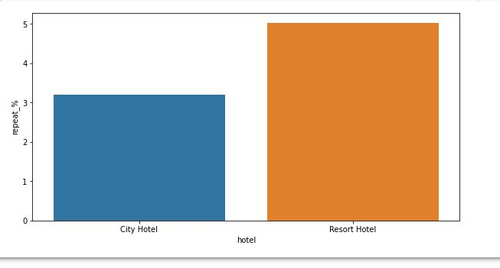
Hotel with high chance that its customer will return for another stay :
Both hotel have very small percentage that customer will repeat but resort hotel has the slightly higher repeat percentage than city hotel.

Slide 22
Conclusions:
The arrival of peoples in 2016 is double compared to 2015 but has gradually decreased in 2017.
Portugal, United Kingdom, France , Spain and Germany are the top countries from most guests arrived.
‘A’ type room is preferred by majority of people.
TA/TO has the highest cancellation percentage.
Most common type meal is BB and least common is undefined

Slide 23
From above two graph ,in the first graph the adults with pair has most reservations and in the second graph adults with zero children is having most booking, so we conclude that the adults without children has more bookings
The percentage of booking of city hotel is 60% and the resort hotel is 36%.
Agent ‘9.0’ has the most number of booking above 30000 bookings and agent ‘8.0’ with least number of booking.
3.86% is the booking percentage of repeated guests and the percentage of new guests is 96.14%.
Most common stay length is less than 4 days and generally people prefer city hotel for short stay, but for long stays resort hotel is preferred.
Both hotels have very small percentage that customer will repeat, but resort hotel has slightly higher repeat percentage than city hotel.

Slide 24
Challenges faced:
There was a lots of duplicate data.
Choosing appropriate visualization techniques to use was difficult.
A lot of null values were there in the data set.

